Slide 1
Front-End Web Development
Module 2 - CSS

Slide 2
Presentation Contents
Linking CSS to HTML
Using CSS
CSS classes

Slide 3
Course objectives
Describe different types of CSS and how it is used in HTML files
Understand factors that affect CSS rules

Slide 4
Types of CSS
There are three types of CSS
Inline CSS
Internal CSS
External CSS

Slide 5
Inline CSS
Inline CSS is applied using the “style” attribute on appropriate HTML Tags
CSS rules are added inline as attribute values
<p style=“background-color: #00004d; width: 80%">
Example Text
</p>

Slide 6
Internal CSS
Internal CSS is applied using a <style> tag inside the <head> section of a HTML file
Internal CSS affects all the elements in the body section
<head> … <style>
body { background-color: #00004d; width: 80%;
}
p { color: #FFFFFF;
}
</style> … </head>

Slide 7
External CSS
External CSS relates to CSS rules which are held in a separate file
CSS files can be referenced by our HTML files by using the <link> tag
By convention our CSS files belong in a dedicated folder
projectname/css/style.css
This keeps our directories clean and makes it easier to find files
<link href="css/style.css" rel="stylesheet" type="text/css“ />

Slide 8
CSS Classes
Internal CSS is applied using a <style> tag inside the <head> section of a HTML file.
Internal CSS affects all the elements in the body section
<head> … <style>
body { background-color: #00004d; width: 80%;
}
p { color: #FFFFFF;
}
</style> … </head>

Slide 9
Example HTML code
<!DOCTYPE html><html> <head> <meta charset="ISO-8859-1"> <title>welcome</title> <link href="css/style.css" rel="stylesheet" type="text/css" /> </head><body> <div class="mainContent"> <div class="navigation"> <ol> <li><a id="home" href="www.qa.com"> Home</a></li> <li><a href="www.qa.com/about-qa"> About</a></li> <li><a href="https://www.qa.com/online-courses">Products</a></li> <li><a href="info@qa.com"> Contact</a></li> </ol>
Link tag referencing CSS files
Class attribute stating which CSS class to apply the specific divided content – CSS classes discussed later.

Slide 10
Example HTML code 2
Class attribute stating which CSS class to apply to a div tag enwrapping a paragraph tag.
<div class="content"> <p>
Example text
<p> </div>

Slide 11
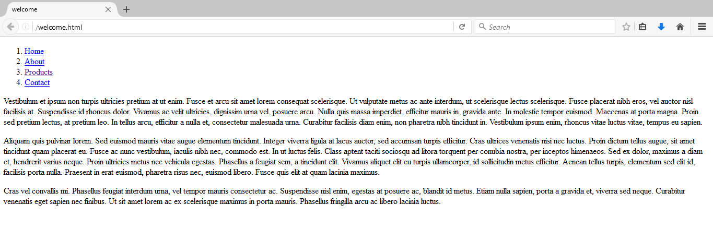
Example Code Without any CSS

Slide 12
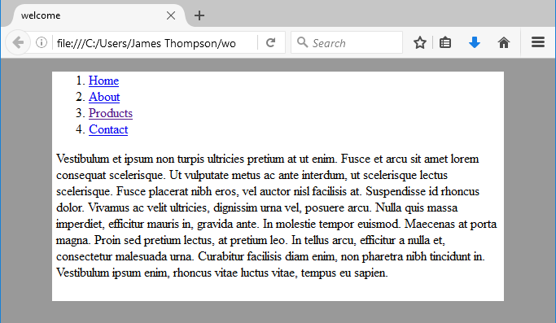
Adding some basic CSS
Within style.css we define our CSS rules in key/value pairs
For now we will apply styles to the <html> and <body> tags
@CHARSET "ISO-8859-1";
html { background-color: #999999; }
body { background-color: #FFFFFF; width: 80%; margin-left: auto; margin-right: auto; }
“margin-left” is auto but could be increased with a value.
Width now set to 80%

Slide 13
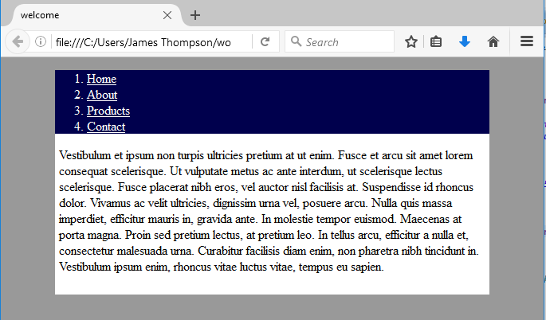
CSS Class Selectors
We can apply styles to groups of tags by assigning them classes using the ‘.’ selector in a CSS file.
.mainContent { padding: 0px 5px 10px 5px; }
.navigation { background-color: #00004d; color: #FFFFFF; }
.navigation a:link { color: #ffffff; }
.navigation a:visited { color: #ffff00; }
Top, right, bottom, left respectively.
background-color: #00004d of “.navigation”
10px padding as applied to class

Slide 14
Practice activities
Add a class named “paragraph” to a <p></p> tag and have a go at writing styling rules for that class using internal CSS to change the font size, change the font colour and centre the text to the middle of the screen.
Discover some style key/values pairs for CSS rules

Slide 15
Solution
<head> …
<style>
. paragraph { color: #0000FF; font-size: 50px; text-align: center;
}
</style> … </head>

Slide 16
CSS id Selector
To style individual HTML elements you can give the element an id attribute which can be accessed using the ‘#’ selector in .css.
When applying styles to classes we can specify tags within that class by adding the tag to the selection separated with a space. As shown with the ordered list tag “ol” in the example.
Elements such as <a> tags also have events which we can apply styles to.
#home { font-weight: bold; }
.navigation { background-color: #00004d; color: #FFFFFF; padding: 0px 0px 0px 0px; width: 100%; display: table; }
.navigation ol { padding: 0px 0px 0px 0px; margin: 0px 0px 0px 0px;
}
.navigation a:visited { color: #ffffff; }

Slide 17
Cascading
CSS or Cascading Style Sheets indicates that the cascade is indeed important. Three factors affect what CSS rules are applied:
Importance
Specificity
Source order

Slide 18
Cascading – Importance
!important will always win over all other inherited or conflicting CSS rules.
In the example “border: none” i.e. to not apply a border around the element, in the class: “.better” would be applied to the paragraph tag.
<p class=“better” id=winning”>
Example Text
</p>
#winning { background-color: red; border: 1px solid black;
}
.better { background-color: red; border: none !important;
}

Slide 19
Cascading – Specificity
Specificity relates to a measure of how specific a selector is. Element selectors have low specificity, class selectors have a higher specificity than element selectors, and ID selectors have a even higher specificity, so will win over class selectors.
In the previous example, red would be applied as the background colour.

Slide 20
Cascading – Source order
In the situation where two rules are applied with the same specificity and no !important rule applied then later rules will override previous rules.
Grey would be applied as the background colour in the example.
<p class=“better”>
Example Text
</p>
.better { background-color: red;
}
.better { background-color: grey;
}

Slide 21
Cascading – Inheritance
All elements inside an element is known as children.
For example, in the case where a <p> tag is inside a <div> tag, the <p> tag is the child of the <div>.The <div> would be known as the parent element of the <p> tag.
Certain property values applied to parent elements will be inherited by child elements. The “color” property is an example of a CSS property that will be inherited by a child.
<div class=“better”>
<p>
Example Text
</p>
</div>
.better { color: red;
}

Slide 22

Box Model
All HTML elements can be considered as boxes. In CSS, the term "box model" is used when talking about design and layout.
The CSS box model is essentially a box that wraps around every HTML element. It consists of: margins, borders, padding, and the actual content. The image below illustrates the box model:
Notes:
https://www.w3schools.com/css/css_boxmodel.asp

Slide 23
CSS Position
The position property specifies the type of positioning method used for an element.
There are five different position values:
Static - Default value. Elements render in order, as they appear in the document flow
Absolute - The element is positioned relative to its first positioned (not static) ancestor element
Fixed - The element is positioned relative to the browser window
Relative - The element is positioned relative to its normal position
Sticky - The element is positioned based on the user's scroll position
Notes:
https://www.w3schools.com/cssref/pr_class_position.asp

Slide 24
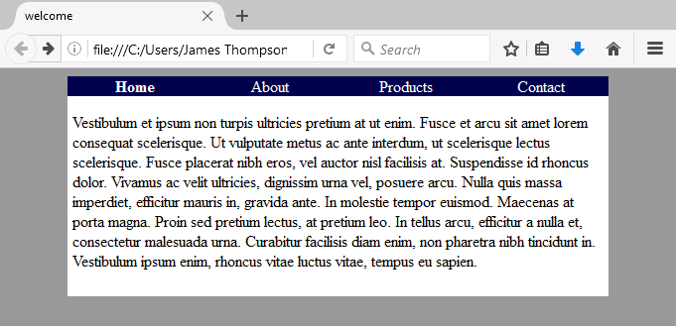
Finishing off the CSS
.navigation li { display: table-cell; text-align: center; vertical-align: middle; float: left; width: 25%; }
.navigation li:hover { background-color: #3333ff; }
.navigation a:link { color: #ffffff; text-decoration: none; }

Slide 25
Before CSS Applied

Slide 26
After CSS Applied

Slide 27
Course Objectives – Summary
Describe different types of CSS and how it is used in HTML files
There are three ways of implementing CSS which are inline, internal and external. We discussed how CSS classes can be used in our HTML file.
Understand factors that affect CSS rules.
Importance, specificity and source order affect what rules are actually applied.

Slide 28
Thank you for listening.
Any questions?

